Slide 1
Consolidated & Consolidated NNE VFO Environment Integration
Integration Completion Date: April 15, 2019

Slide 2
Consolidated Communications VFO Integration Overview
All Consolidated Legacy orders will be integrated into the NNE environment the weekend of April 13, 2019.
“Elink” / “FairPoint” in the URL will be replaced by “Consolidated”
https://vfoprod-consolidated.activationnow.com
User Names are staying the same.
NNE will use their existing user ID in the Consolidated URL.
Consolidated Legacy will use their existing user names in the new URL starting 4/15/2019.
Users ordering from both territories will use the NNE user ID to view orders sent to both territories starting 4/15/2019.
The same functions will be retained for the different territories.
Consolidated Legacy will still support ASR ordering.
Consolidated NNE will still support ASR Ordering and Preordering, LSR Ordering and Preordering as well as Trouble Administration.

Slide 3
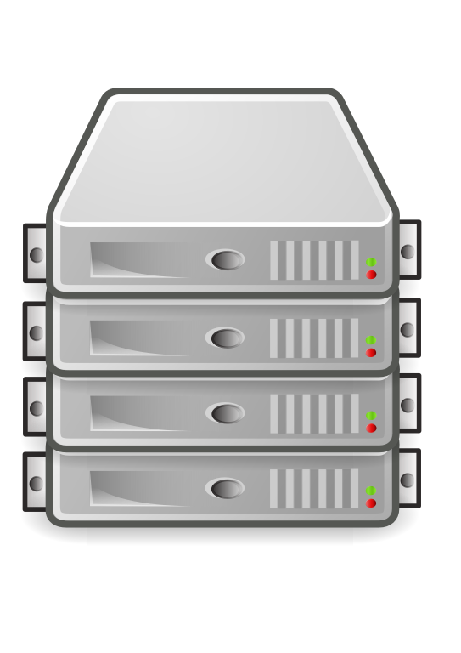
Consolidated Communications is Integrating the Front-End of the Ordering Process
Consolidated NNE
EC20 and FP01
Consolidated Legacy
CC05, ET02, EV10, FB01, IO01 IC90, LF10, MK01 NP05, PT30, RS02
User enters order using one VFO application or their own ordering system that e-bonds to Synchronoss gateway.
Synchronoss’ gateway application looks at the ICSC code to determine the path of the order.

Slide 4
Consolidated Legacy and Consolidated NNE
What ICSC values are considered Legacy and what are nne?
Consolidated Communications – ASR ICSC codes
Consolidated NNE
States: ME, NH, VT
EC20 – FairPoint Enhanced Communications (CES product)
FP01 – FairPoint Communications
Consolidated Legacy
States: CA, IL, KS, MN, MO, ND, PA, TX
CC05 - CONSOLIDATED COMM. TELCOM SRVS., MATTOON, IL
ET02 - ENVENTIS TELECOM (a.k.a. MINNESOTA POWER TELECOM), DULUTH, MN
EV10 - CONSOLIDATED (Kansas and Missouri)
FB01 - CONSOLIDATED COMMUN OF FORT BEND CO(PREV FT. BEND TELEPHONE CO), IRVING, TX
IC90 - ILLINOIS CONSOLIDATED TEL, MATTOON, IL
IO01 - IDEAONE TELECOM GROUP L.L.C., FARGO, ND
LF10 - CONSOLIDATED COMMUNICATIONS OF TEXAS COMPANY(PREV TXU COMMUN TELE CO), LUFKIN, TX
MK01 - MANKATO CITIZENS TEL CO, MANKATO, MN
NP05 - NORTH PITTSBURGH TELCO, GIBSONIA, PA
PT30 - PENN TELECOM INC., CRANBERRY TWSP, PA
RS02 - SUREWEST TELEPHONE (PREV ROSEVILLE TELCO), CITRUS HEIGHTS, CA

Slide 5
Enhancements to Virtual Front Office
What to expect in VFO 16.8
VFO 16.8 has some enhancements taking place at the same time as the integration on April 15, 2019.
You will be able to filter ASR orders to show just Multi-EC orders and/or RPON orders.
You will be able to reset your password or retrieve a forgotten user name. There are a few steps you will need to follow first, in order to set this up. See the next page for more information on this feature.

Slide 6
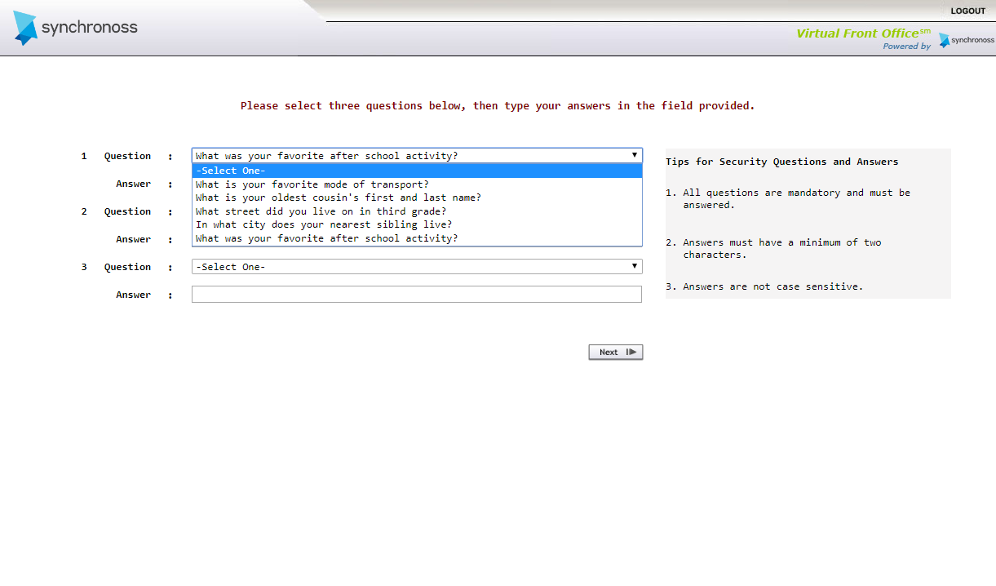
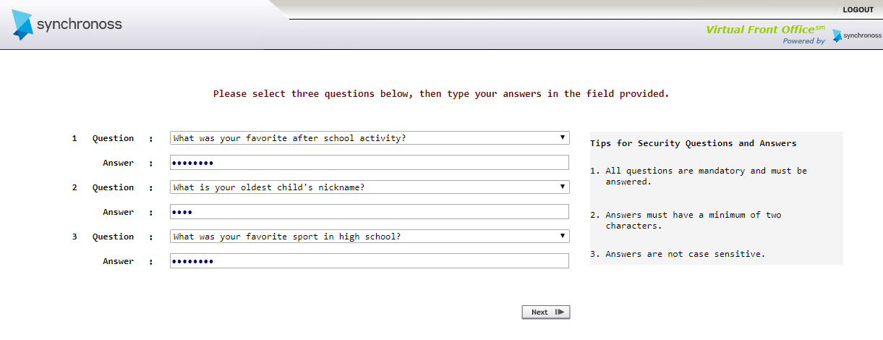
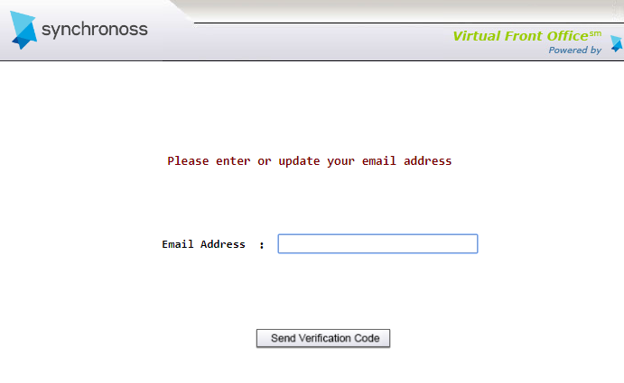
Setting Up New Security
What’s new in VFO 16.8
The first time you log in after the release, you will be prompted to select three security questions and provide answers to each. This is case sensitive, so pay attention to the case you are using when entering your answers.
Once that step is completed you will need to provide your email address or verify the one on file.

Slide 7
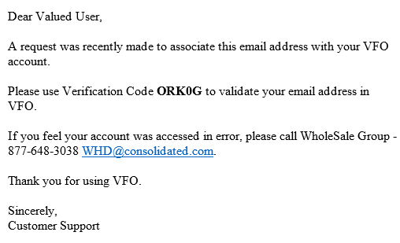
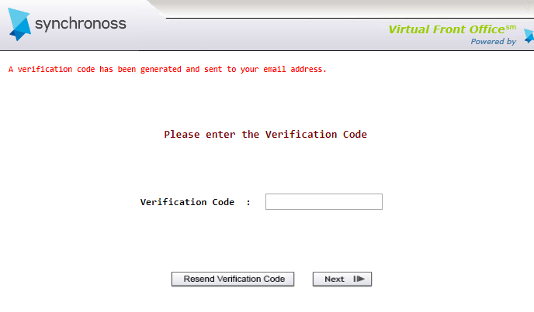
Setting Up New Security – Cont’d
What’s new in VFO 16.8
Your email address will be validated and a verification code will be sent to the email address provided. (If you do not see the email, please check your junk email folder.)
You will then enter the verification code to proceed.
You can now use the “Forgot User Name” or “Forgot Password” links on the log in page.

Slide 8
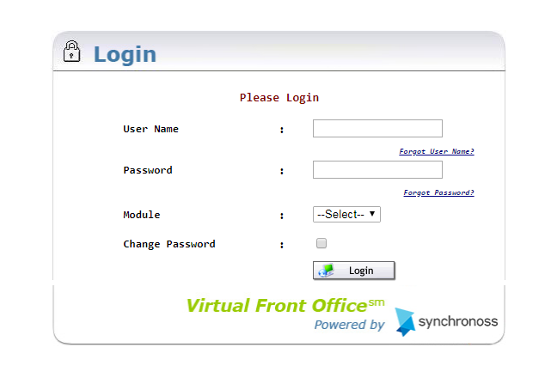
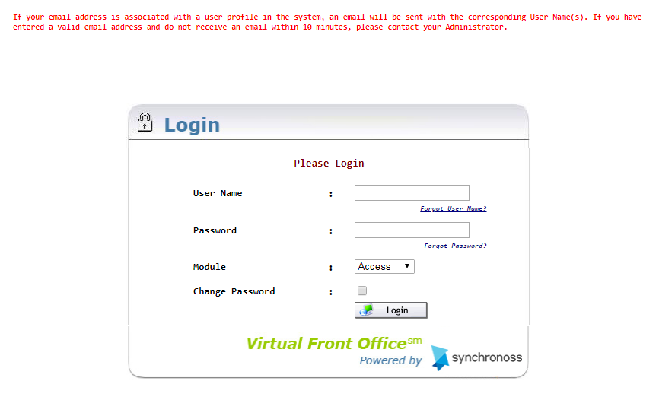
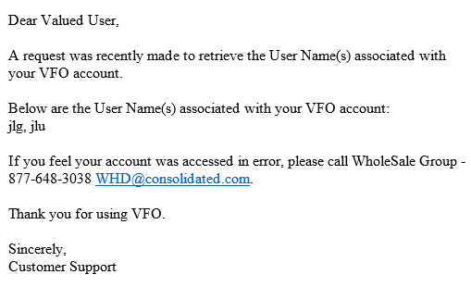
If you forget your User Name
Steps to request your User Name
Click the “Forgot User Name?” link.
Enter your Email Address and click “Send.”
You will receive an email with all the user names matching that email address.

Slide 9
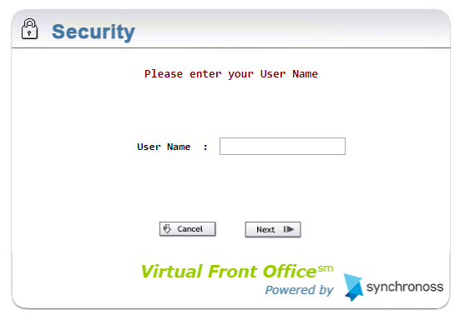
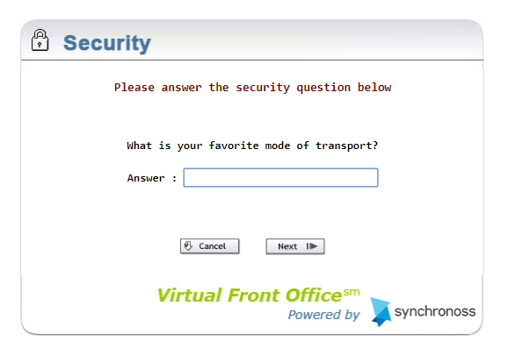
If you forget your Password
Steps to reset your password
Click “Forgot Password.”
Enter User Name and click “Next.”
Answer the randomly generated security question associated with your user profile and click “Next.”

Slide 10
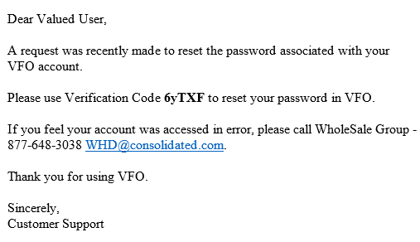
If you forget your Password – Cont’d
Steps to reset your password
VFO will send a verification code. Enter the code and click “Next.”
Enter your password twice and click “Update Password.”
Your password is reset.

Slide 11
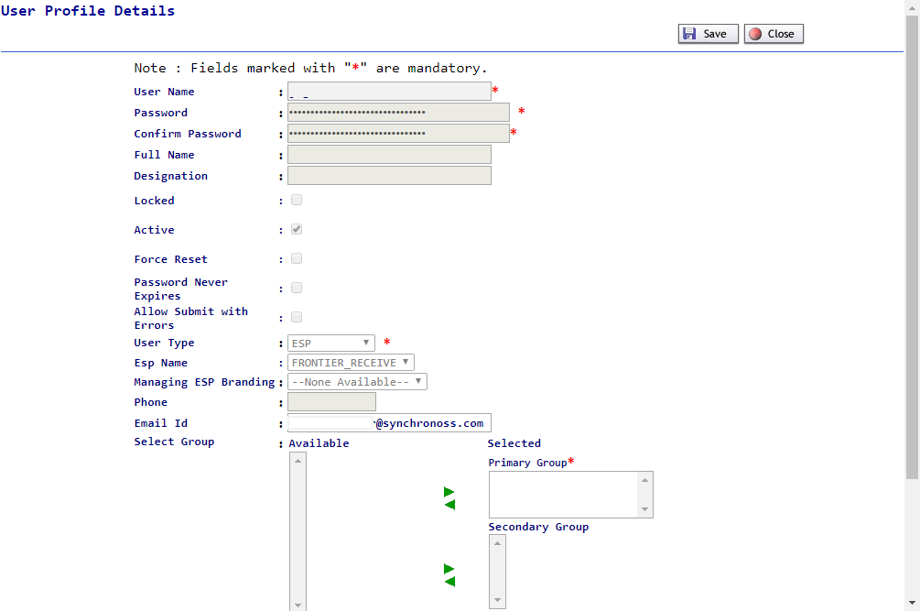
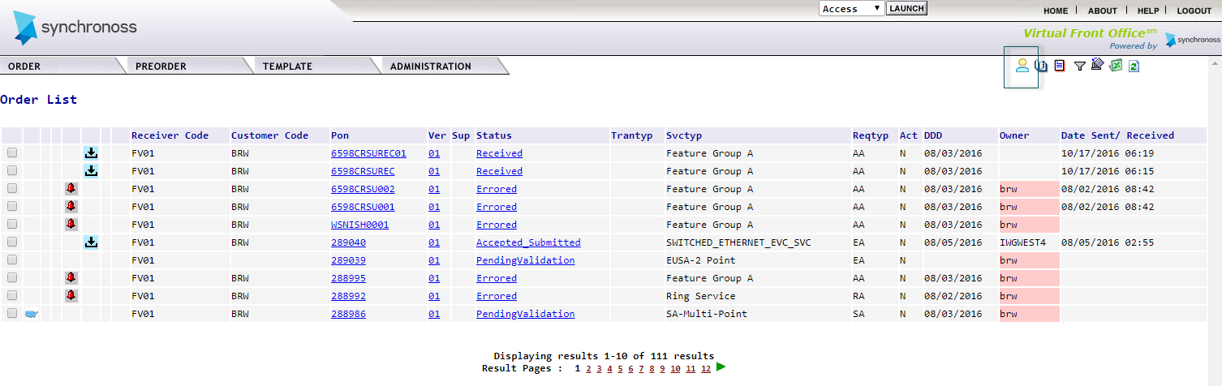
New User Profile Icon
What’s new in VFO 16.8
On the home page, you can manage your emails and security questions by clicking the new User Profile icon.
You can update your email address if it changes,
and/or select different security questions and
change answers.

Slide 12
Instructions for April 15, 2019
What will I do on April 15, 2019?
Update the old bookmark URL to the new URL: https://vfoprod-consolidated.activationnow.com
Log into https://vfoprod-consolidated.activationnow.com with your current user name and password.
Select and answer 3 security verification questions.
Enter or verify your email address.
Look for the email with your verification code.
Enter a verification code.
Begin using VFO.

Slide 13
What’s new for Consolidated Legacy users?

Slide 14
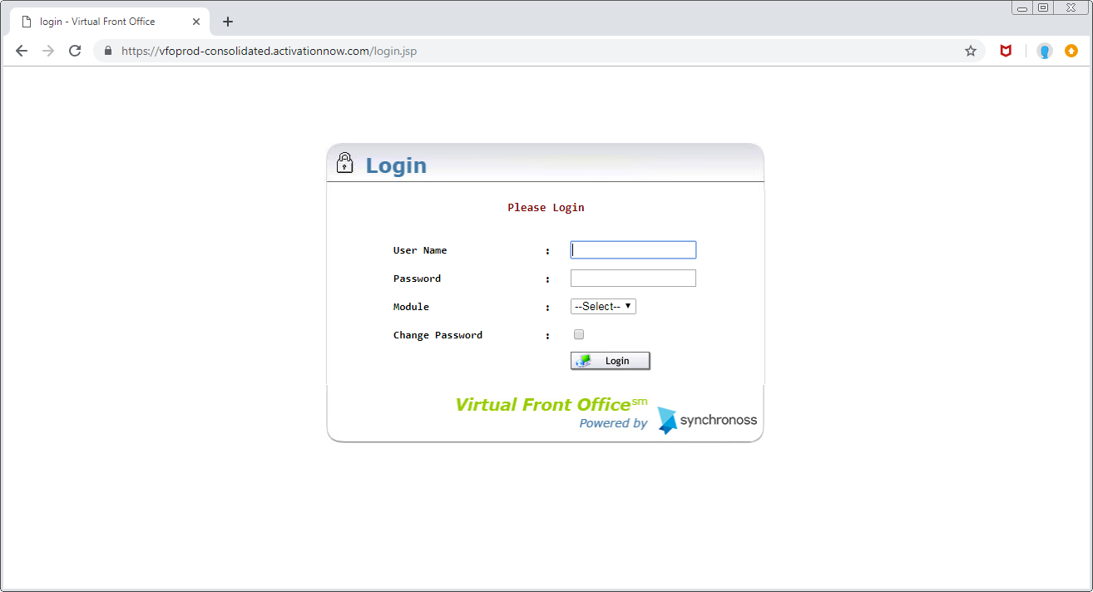
Logging In
What’s New for Consolidated Legacy?
You will use the new URL https://vfoprod-consolidated.activationnow.com to log in.
Remember to edit the bookmarked URL.
Log in using your Consolidated Legacy User Name and Password.
All your Consolidated Legacy transactions will be available.
You can place service requests using ICSC values for Consolidated Legacy.

Slide 15
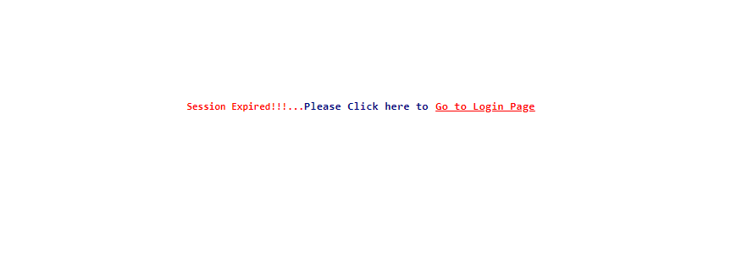
VFO Session Timeout
What’s New for Consolidated Legacy?
You will be timed out of VFO after 4 hours of inactivity, instead of two.

Slide 16
VFO Order List
What’s New for Consolidated Legacy?
The columns on the order list can now be customized.
There are two new columns that are part of the default Order List - ORD and CD Date.
Scroll to the bottom for the VFO Work List Filter and click the columns you want to see (by default, all columns appear).
Remember to click OK.

Slide 17
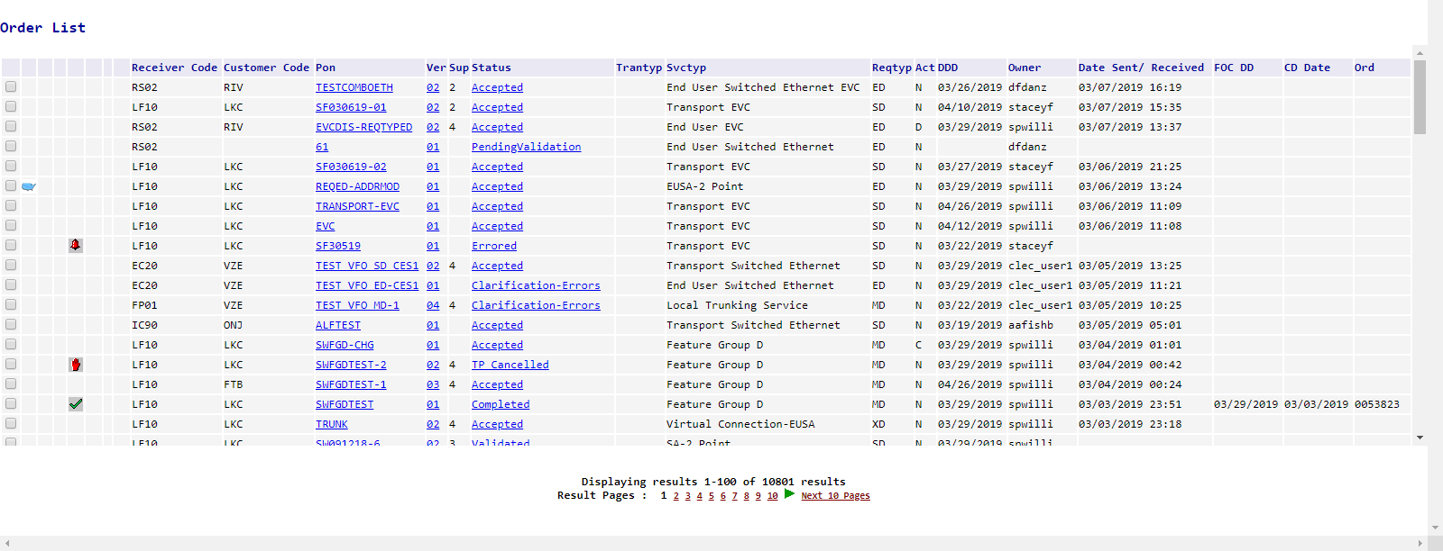
VFO Order List
What’s New for Consolidated Legacy?
Here is an example of the Order List with all columns displayed:

Slide 18
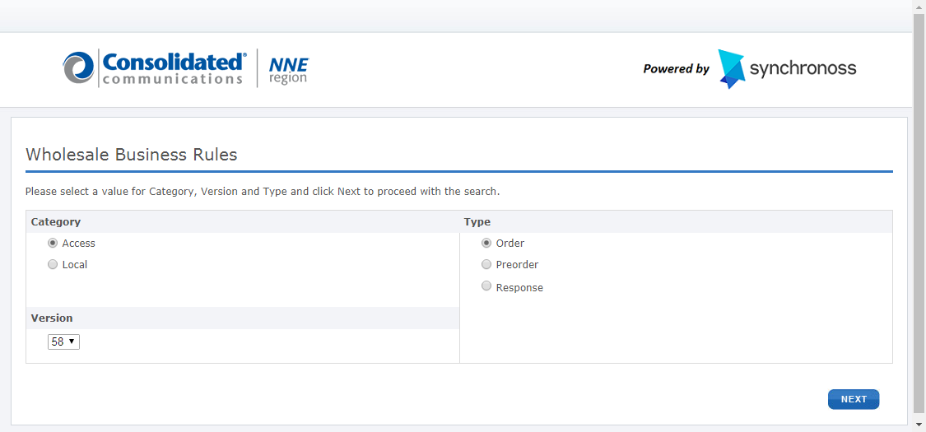
New VFO Access Service Help
What’s New for Consolidated Legacy?
The VFO Help has “Wholesale Business Rules” with Consolidated specific rules.
Click “Wholesale Business Rules” and select the type of rules you want to view, Order or Response, then click Next.

Slide 19
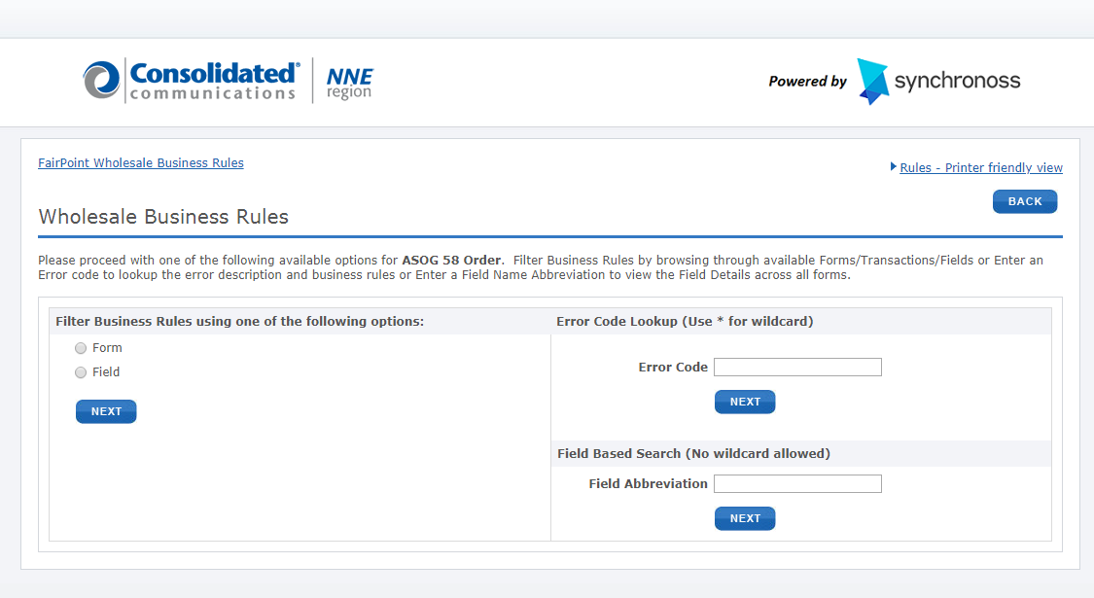
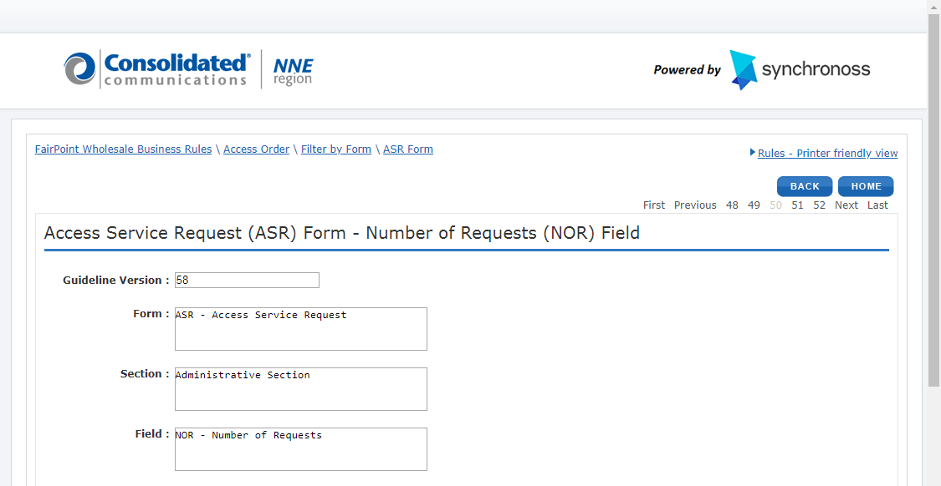
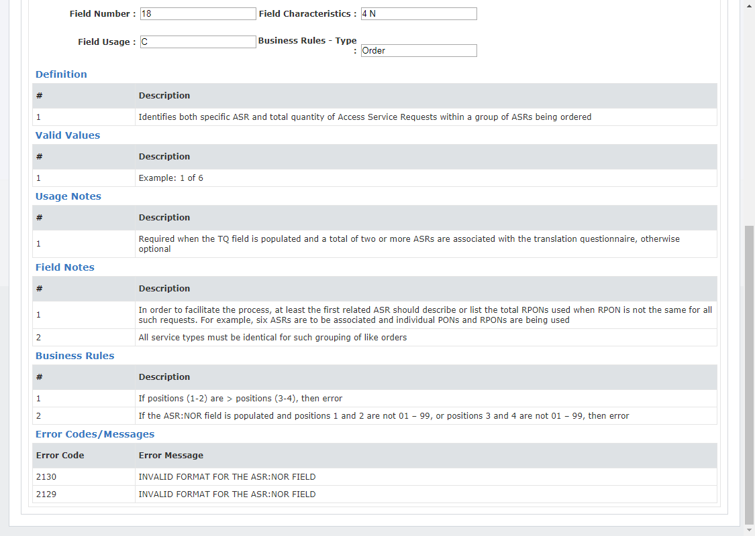
New VFO Access Service Help
What’s New for Consolidated Legacy?
You can search by 1) form, 2) field, 3) error code, or 4) field abbreviation, then click “Next.”
c
c
NOTE: You will find the same type of information with the addition of the actual coded business rules, error codes and error messages.

Slide 20
What’s new for Consolidated NNE users?

Slide 21
Logging In
What’s New for Consolidated NNE?
You will use the new URL https://vfoprod-consolidated.activationnow.com to log in.
Remember to edit the bookmark.
Log in using your Consolidated NNE User Name and Password.
All of your Consolidated NNE transactions will be available.
You can place service requests using ICSC values FP01 and EC20.

Slide 22
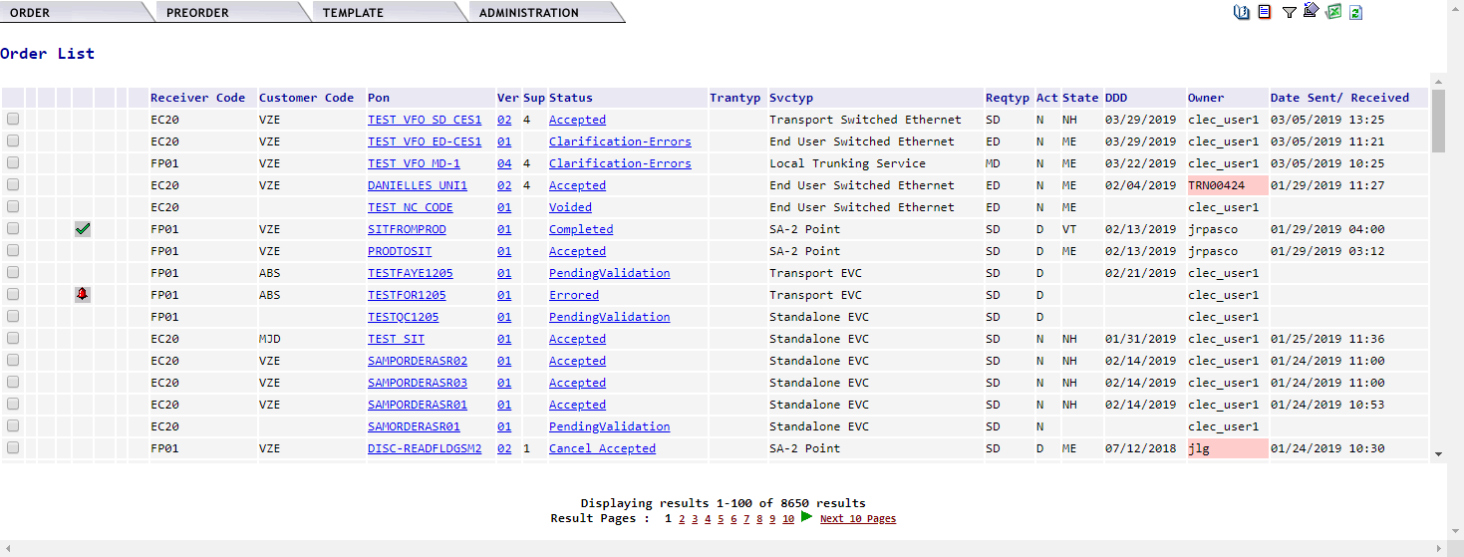
Order List – State Column
What’s New for Consolidated NNE?
When the State population criteria is met, the State for this order will appear on the Order List.
Criteria for the State population:
If Reqtyp = M, A, L, V, W, R, or S, then position 5-6 in ASR ADMIN ACTL field is used.
If Reqtyp = S and ASR.ADMIN.EVCI is populated, then position 5-6 in EVC.EVCSP field is used.
If Reqtyp = E or X, then EUSA PRILOC SALI STATE is used, if blank then the EUSA SECLOC SALI STATE is used.

Slide 23
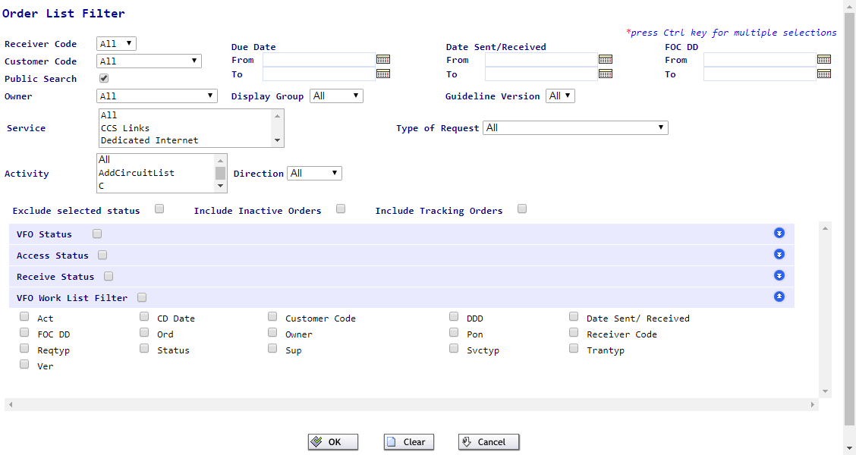
VFO Filter
What’s New for Consolidated NNE?
You will now be able to filter on the PON’s FOC Due Date (DD).
You will be able to select multiple service types and activities. Hold the CTRL key down while making your selections. Note: You are limited to 3 selections.

Slide 24
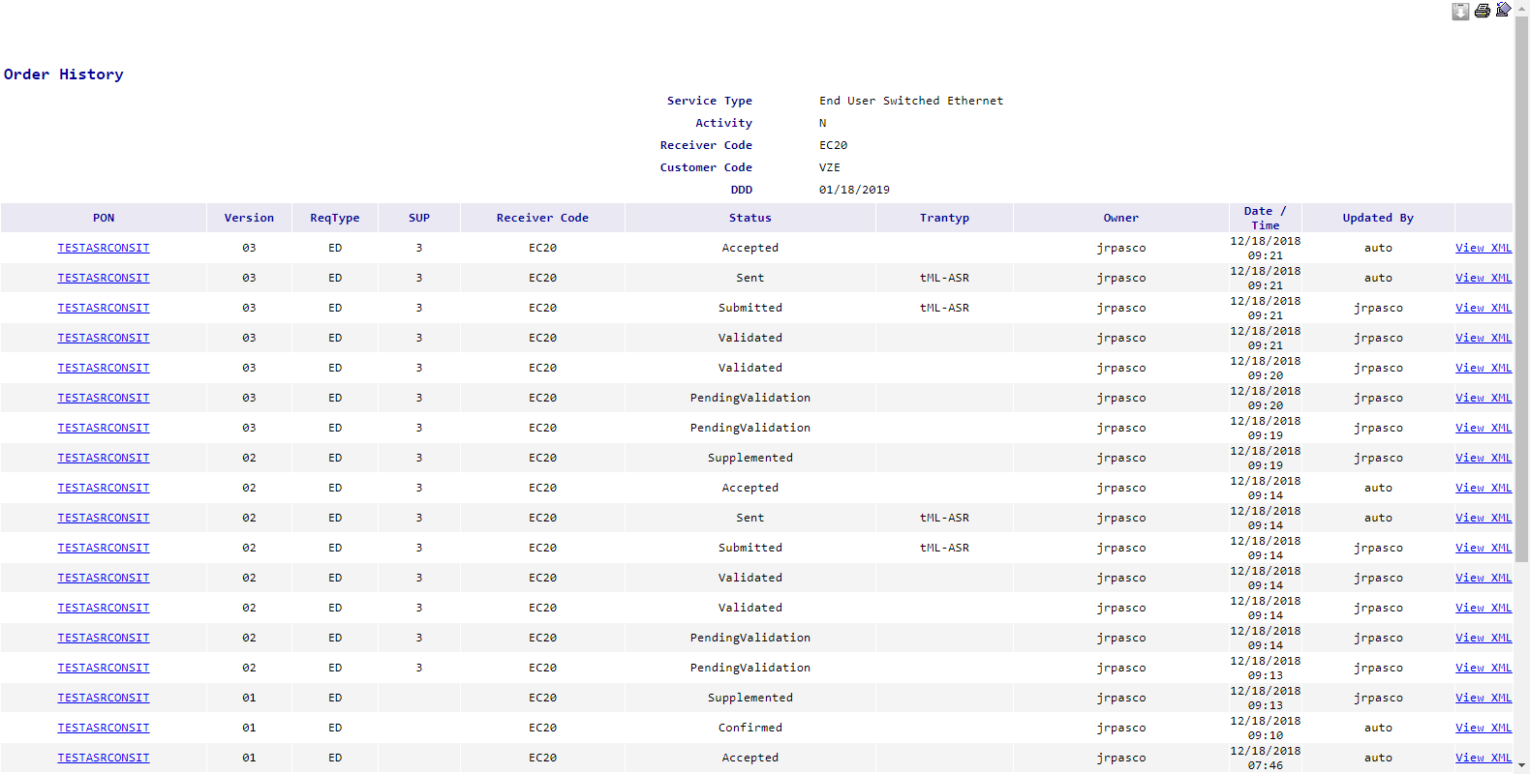
History Screen
What’s New for Consolidated NNE?
The list of transactions on the History screen will contain up to 50 records before you need to move to the next page.

Slide 25
What users doing business in all Consolidated territories can expect

Slide 26
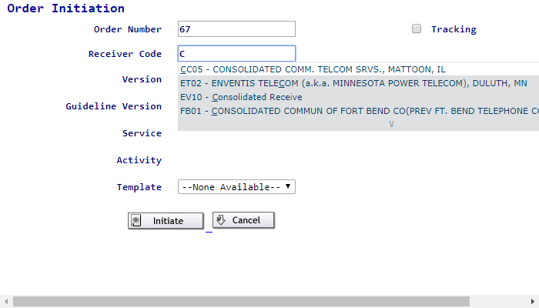
Logging In
What Users Doing Business with NNE and Legacy can Expect
You will use the new URL https://vfoprod-consolidated.activationnow.com to log in.
Remember to edit the bookmark.
Log in using your NNE User ID and Password. This is now your Consolidated User ID.
All your Consolidated (NNE and Legacy) transactions will be available.
You can place service requests using ICSC values for either NNE or Legacy.

Slide 27
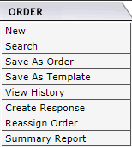
Reassigning PONs
What Users Doing Business with NNE and Legacy can Expect
This is not new functionality but you may find a new need for it after the integration.
If you see any active Legacy PONs you want to appear when you are logged in with your “NNE” user name, you can reassign it to your now “Consolidated” user name.
Click the radio button next to the PON on the Order List.
Hover your mouse over the Order tab and click “Reassign Order.”
Your user name will appear in the Assign Owner drop down box.
Click Save.
You can now filter with your Consolidated user name to see all your PONs.

Slide 28
VFO Session Timeout
What Users Doing Business with NNE and Legacy can Expect
You will be timed out of VFO after 4 hours on inactivity. This was previously 2 hours in the Consolidated Legacy environment.

Slide 29
VFO Order List
What Users Doing Business with NNE and Legacy can Expect
You are retaining the ability to customize the VFO Work List.
You open the Filter, scroll to the bottom, and select what columns you want to appear in the Order list.
Now both Consolidated NNE and Legacy can include ORD and CD Date in the Order List.
By default all columns will show. If you click the check boxes, only those checked will appear.

Slide 30
VFO Filter
What Users Doing Business with NNE and Legacy can Expect
You will be able to filter on FOC DD.
You will be able to select multiple Service types and activities. Hold the CTRL key down while making multiple selections. Note: You can select a maximum of 3 selections.

Slide 31
VFO Order List
What Users Doing Business with NNE and Legacy can Expect
Here is an example of the Order List with all columns displayed:

Slide 32
History Screen
What Users Doing Business with NNE and Legacy can Expect
The list of transactions on the History screen will contain up to 50 records instead of the previous 10 records per page viewed in the NNE environment.

Slide 33
Thank You

